Slide 1
GME Finance Icon in GME App

Slide 2
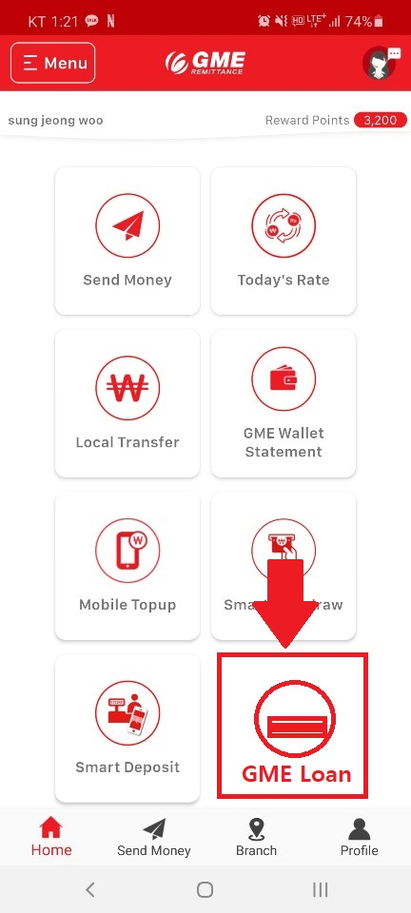
1. Add icon in blank space

Slide 3
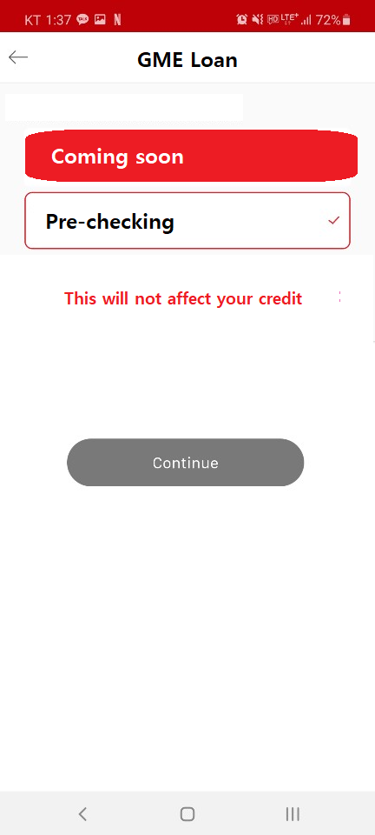
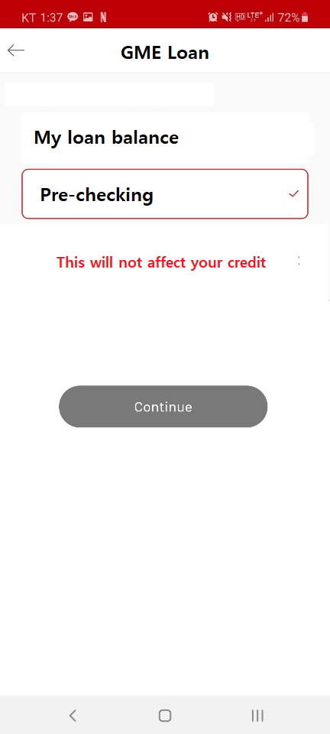
2. Content
For now
2) After integrate GME R & F
The process is quick and easy,
and it will NOT affect your credit score.

Slide 4
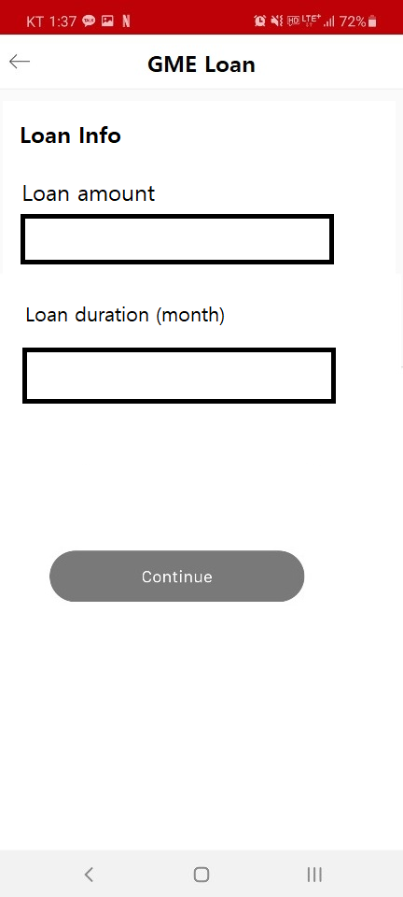
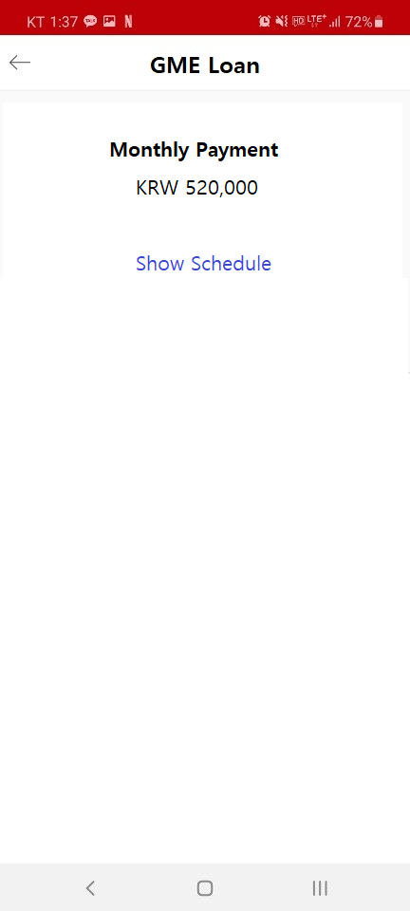
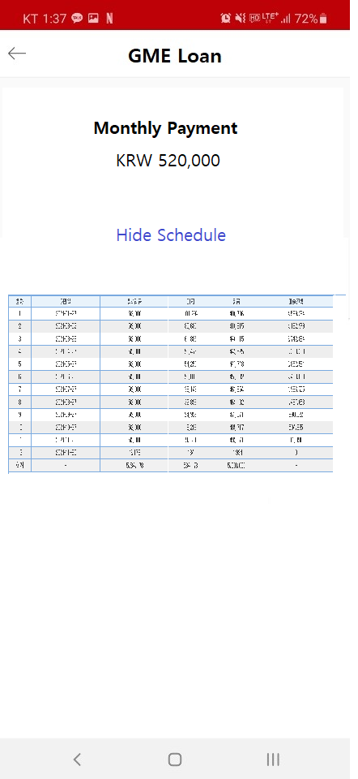
3. Pre-checking

Slide 5
5. My loan balance
Click my loan balance
ID No.
Xxxxxx-xxxxxxx
Input ARC only
Input ARC no. should be same as GME remit reg id

Slide 6
